Slide 1
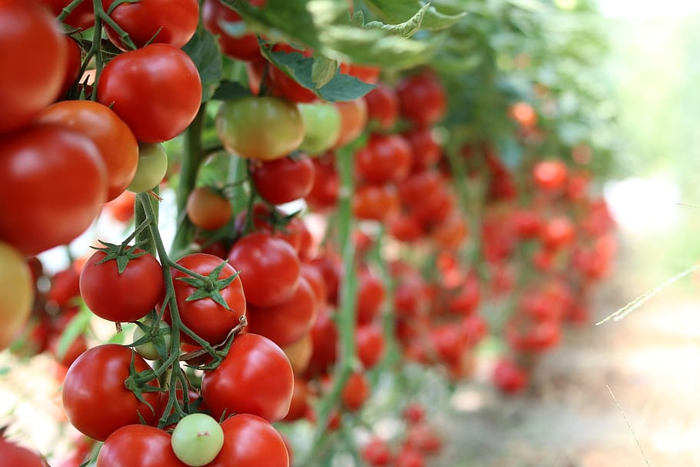
TOMATO DISEASE CLASSIFICATION USING CONVOLUTIONAL NEURAL NETWORKS
PRESENTED BY
SAPTANIL GHOSE
MIR MARUF AHMED
MOHAMMAD IMTIAZ NAKIB
MOST. AFROJA MAHOMUDA

Slide 2
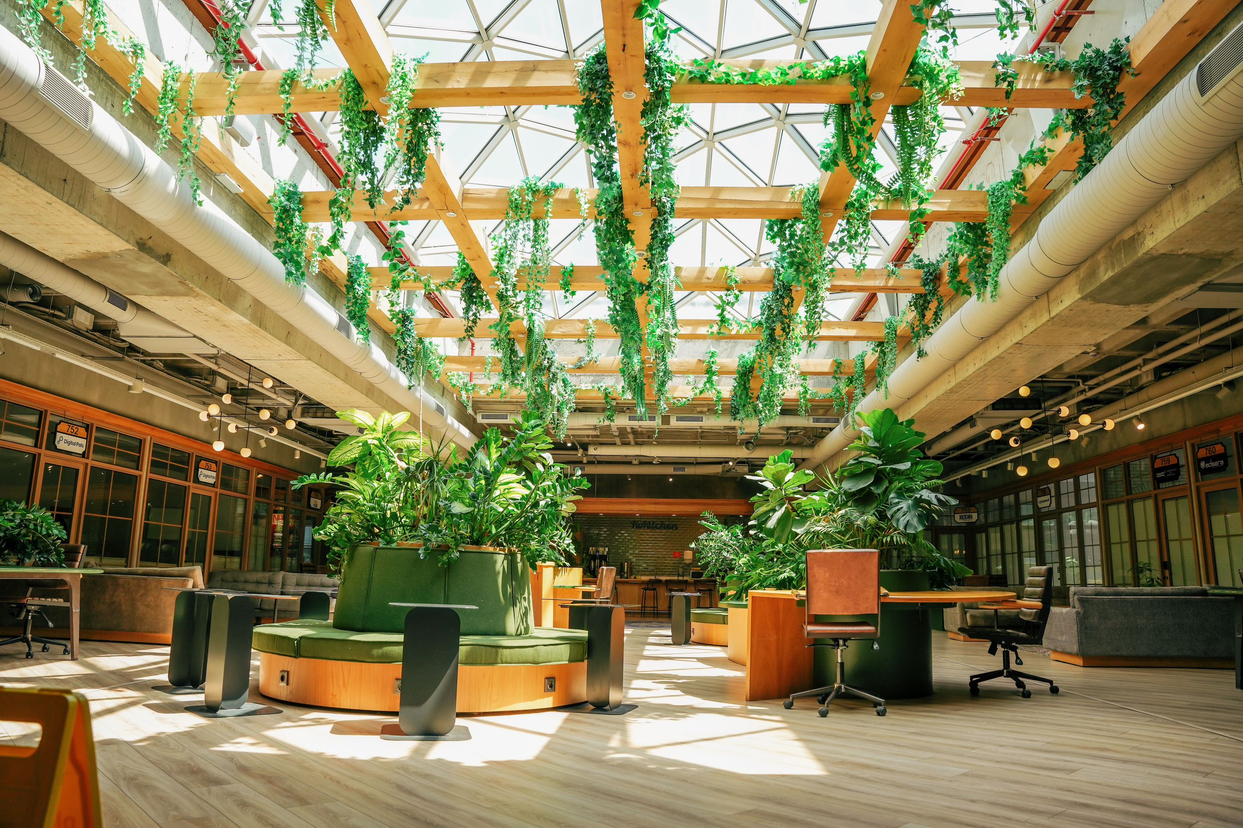
OUTLINE OF THE PRESENTATION
THE PRESENTATION WILL BE DISCUSSED IN THE FOLLOWING ORDER
INTRODUCTION
ABOUT THIS RESEARCH
HOW AI IS HELPING IN AGRICULTURE
WHY TOMATO IS IMPORTANT?
LITERATURE REVIEW
METHODOLOGY
MODEL ARCHITECTURE
RESULT ANALYSIS
COMPARE RESULT
CONCLUSION

Slide 3
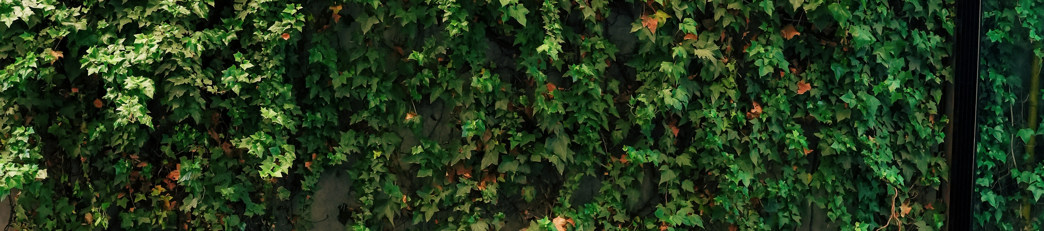
INTRODUCTION
Essential to preserving global food security and economic stability.
Tomatoes are a significant crop with widespread consumption.
Disease management is crucial for sustainable and environmentally friendly agriculture.
Reduces reliance on harmful pesticides.
Contributes to healthier crops, better nutrition, and a more resilient food supply chain.

Slide 4
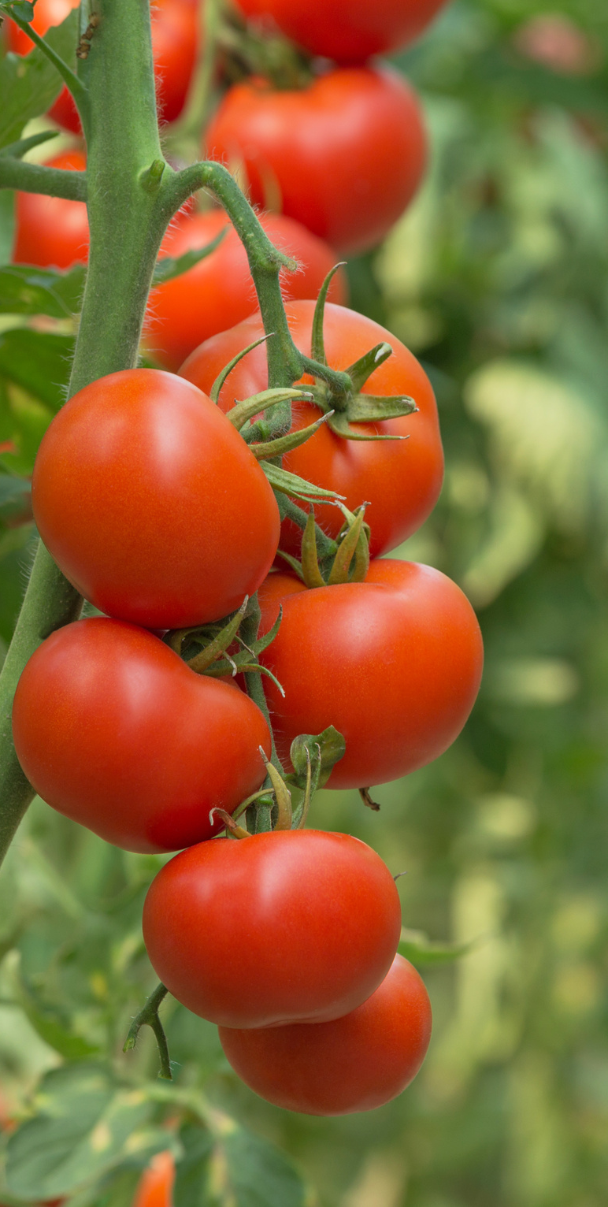
ABOUT THIS RESEARCH
Discussed plant diseases disrupt growth and impact crop yields
Plant disease classification
CNN model
Features extracted from digital photos for recognition
Focus on tomato diseases: Bacterial Spot, Black Mold, etc.
Methodology: CNN-based classification model
High accuracy reported at 98%
The paper discusses research gaps, future directions and challenges
Sections: Introduction, Literature Review, Methodology, Results Analysis, Challenges, Future work, Conclusion and References

Slide 5
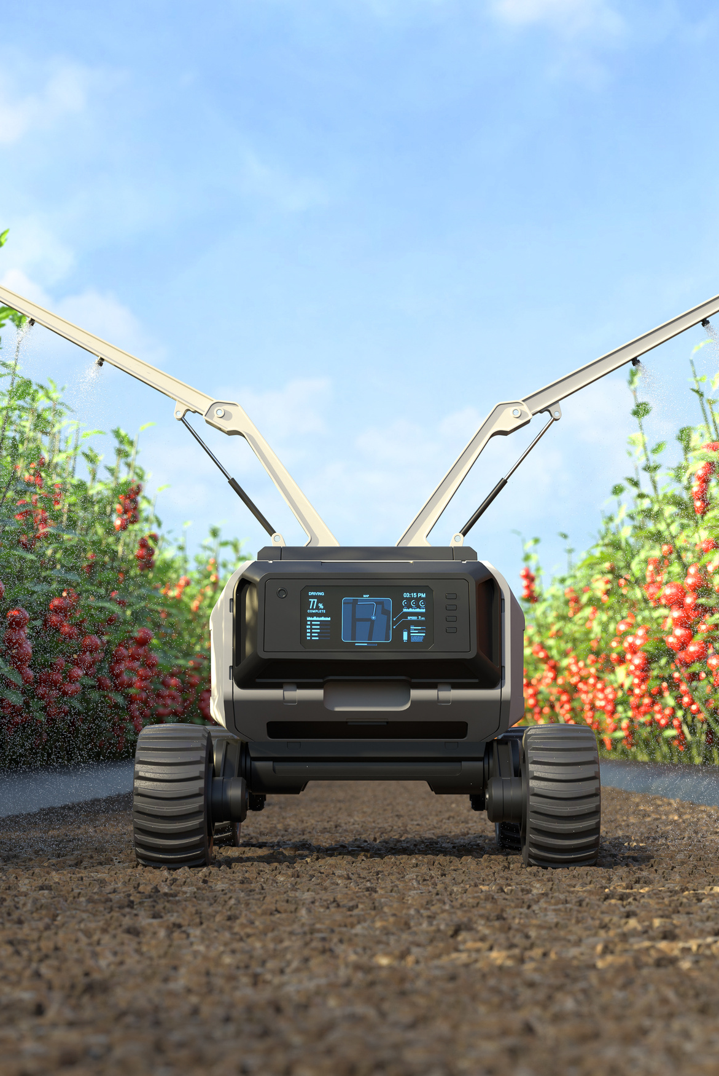
HOW AI IS HELPING IN AGRICULTURE
AI predicts crop yields with weather, soil and historical data
Robots and drones manage weeds and pests, reducing chemicals
AI improves livestock health through genetic analysis
Streamlines farm management for resource efficiency
Maximizes crop yield and minimizes resource waste

Slide 6
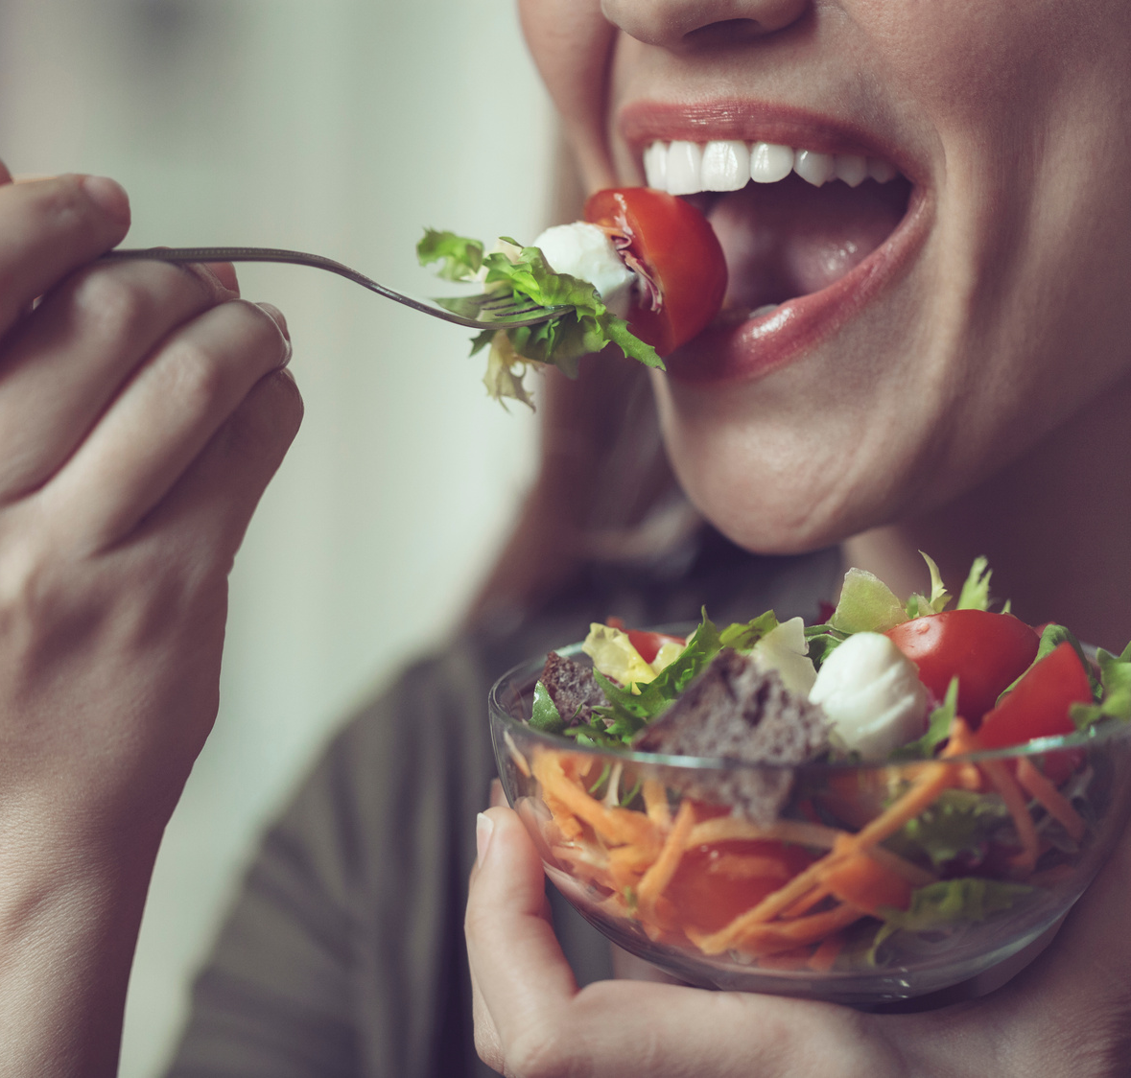
Tomatoes are packed with essential vitamins, minerals, and fiber.
They are used in various global dishes, from sauces to salads.
Tomatoes contain lycopene, an antioxidant with potential health benefits.
Tomatoes are a vital crop that supports economies.
An array of tomato cultivars offers different flavors, sizes, and colors.
Tomatoes are used in ketchup, sauces, and canned forms.
Tomatoes are a staple food, enhancing global food security.
They add flavor, color, and texture to dishes worldwide.
Tomatoes are integral to a wide range of cuisines and recipes.
The tomato industry contributes significantly to agricultural economies.
WHY TOMATO IS IMPORTANT?

Slide 7


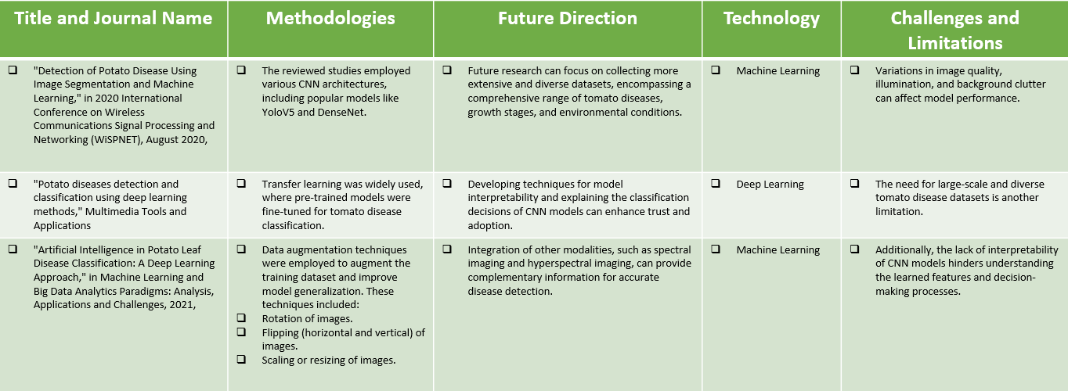
LITERATURE REVIEW

Slide 8

METHODOLOGY
Tomato crops are vital for global food security and agriculture, but diseases pose a serious threat, causing yield losses and reduced quality. Timely and precise disease detection is crucial for effective management. Computer vision techniques, including CNN, have shown promise in automating disease detection and classification in tomatoes. We utilized custom CNN architecture for this purpose.

Slide 9

WHY CNN?
METHODOLOGY
CNNs excel at recognizing features in images.
To learn features of increasing complexity through layers.
Can identify features regardless of position.
Can adapt to various input sizes and image dimensions.
CNNs consistently achieve top results in image classification.
Efficient training and deployment with advanced hardware.

Slide 10
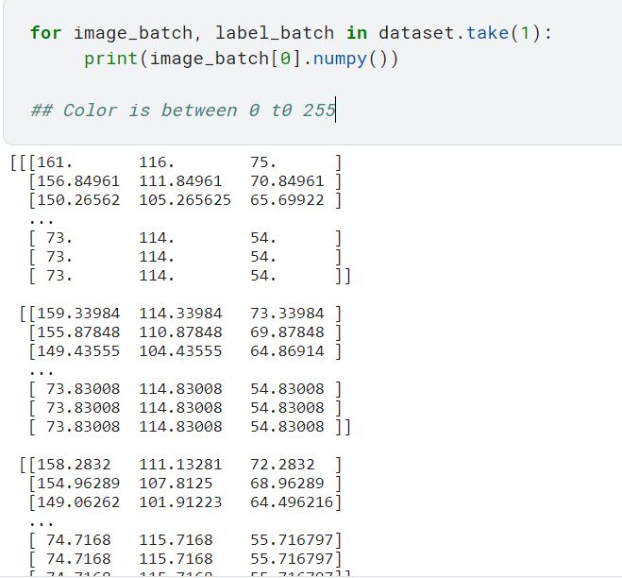
FEATURE EXTRACTION
METHODOLOGY
Captures Hierarchical Patterns
Reduces Dimensionality
Enhances Robustness
Accelerates Training
Here, 0 indicates the darkest spot and 255 indicates the brightest spot.

Slide 11
METHODOLOGY
IMAGE PREPROCESSING
Loaded a dataset using cv2.imread and resized images to 256x256 pixels.
Converted resized images to NumPy arrays for processing.
From 3978 images, we chose a batch size of 32 for training, resulting in 125 batches.
Split the data into 80% training, 10% validation, and 10% testing sets.
Shuffled images 1000 times for enhanced randomness.
Applied data augmentation techniques.
Random Flip (horizontal and vertical) from Keras.
Random rotation with a parameter of 0.2 for introducing data variations.
Utilized color histograms to extract features, enhancing diversity and robustness during training.

Slide 12
METHODOLOGY
PROPOSED METHODOLOGY
Conversion of RGB images to NumPy arrays for machine learning compatibility.
Architecture includes 16 layers: Conv2D, MaxPooling2D, Flatten, and Dense.
Feature learning through Conv2D and MaxPooling2D layers to extract complex features.
Flattened layer prepares output for further processing in the neural network.
Softmax and ReLU activation functions introduce non-linearity for complex pattern learning.
Activation functions, crucial for non-linear transformations, determine neuron outputs.
Softmax activation in the final Dense layer produces output probabilities for disease classification.

Slide 13
METHODOLOGY
EXPERIMENTAL SETUP
Python, Tenserflow and Keras used for model development, leveraging simplicity and versatility.
NumPy for mathematical operations, pandas, and matplotlib for dataset visualization.
Specialized CNN architecture achieved an impressive mean testing accuracy of 98%.
Dataset augmentation techniques significantly improved accuracy.
Presented confusion matrix and performance measurements for model assessment.

Slide 14
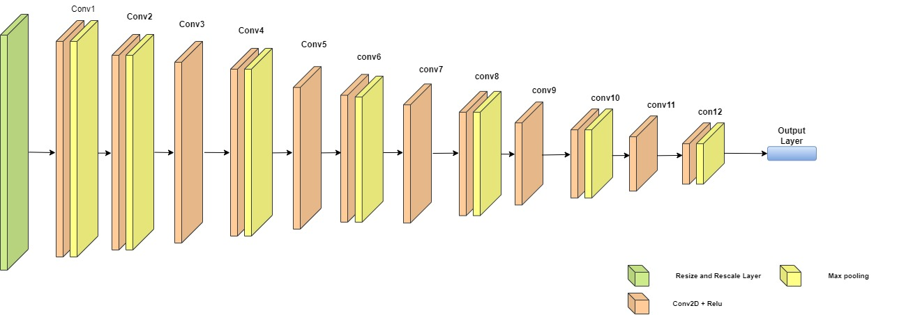
CNN BASE MODEL ARCHITECTURE

Slide 15
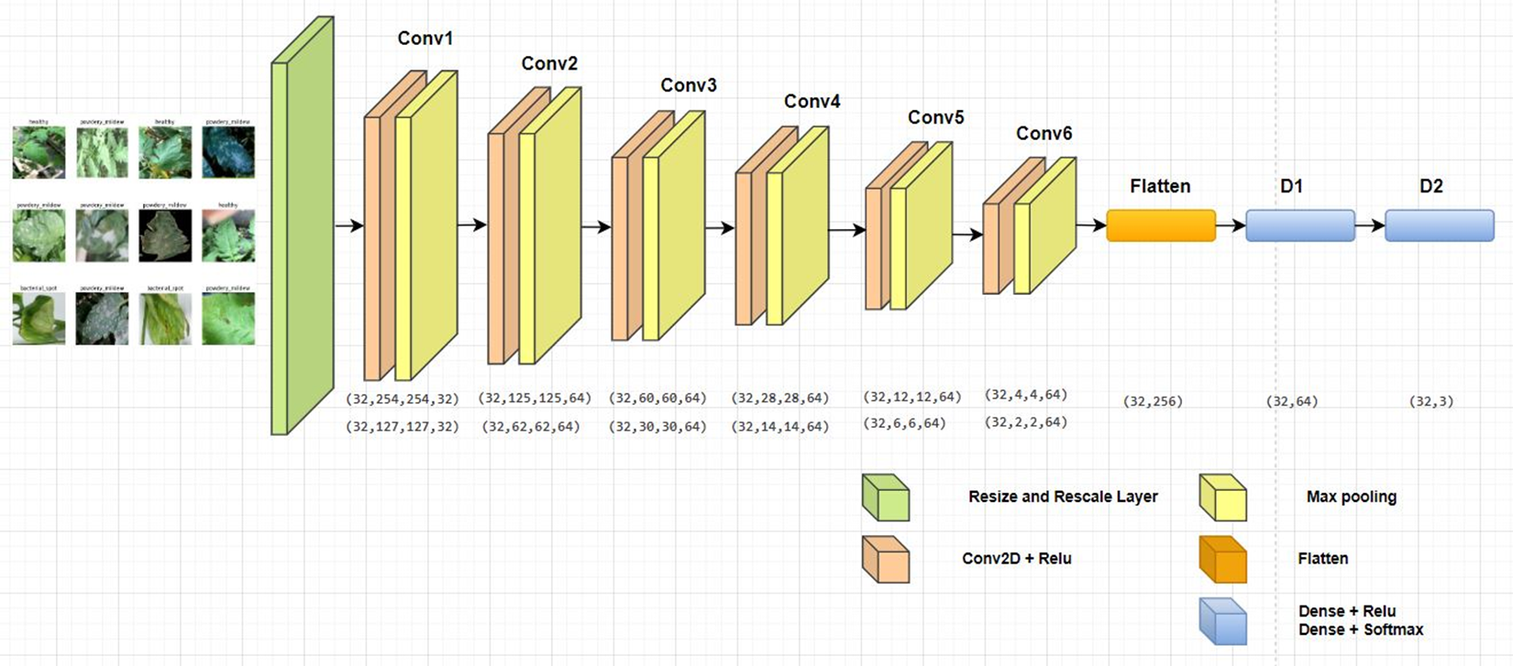
PROPOSED CNN MODEL ARCHITECTURE

Slide 16
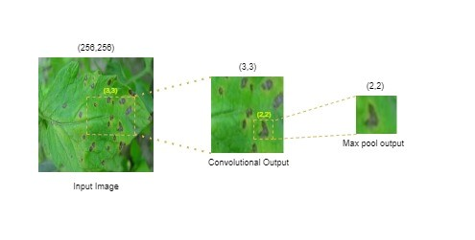
HOW CNN LAYERS DETECT DISEASES

Slide 17
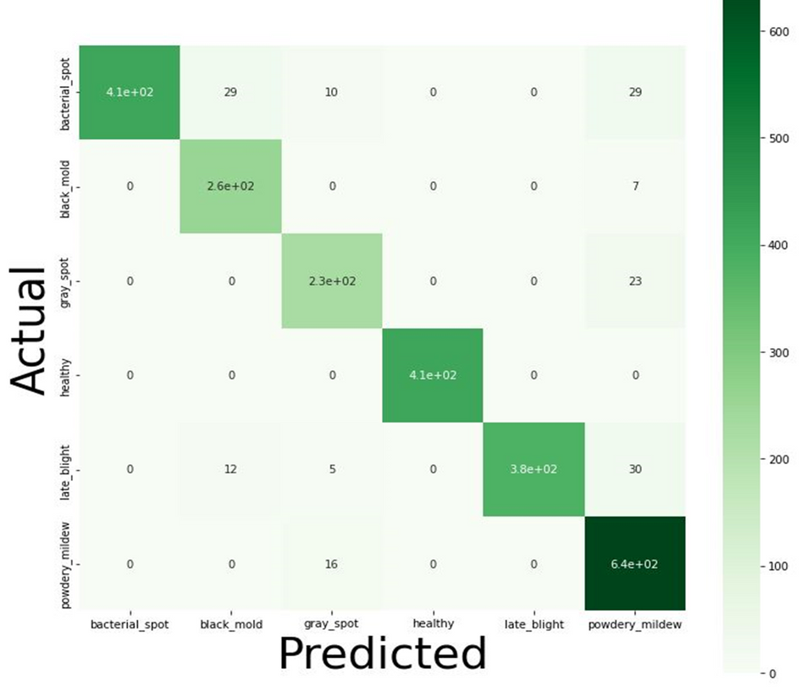
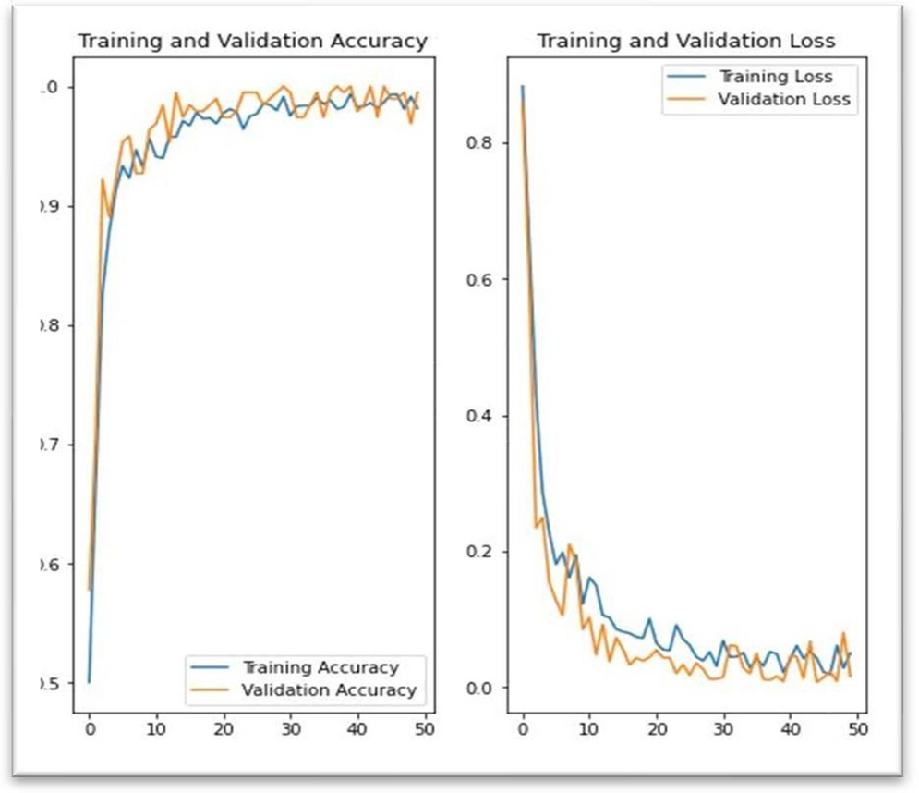
RESULT ANALYSIS

Slide 18
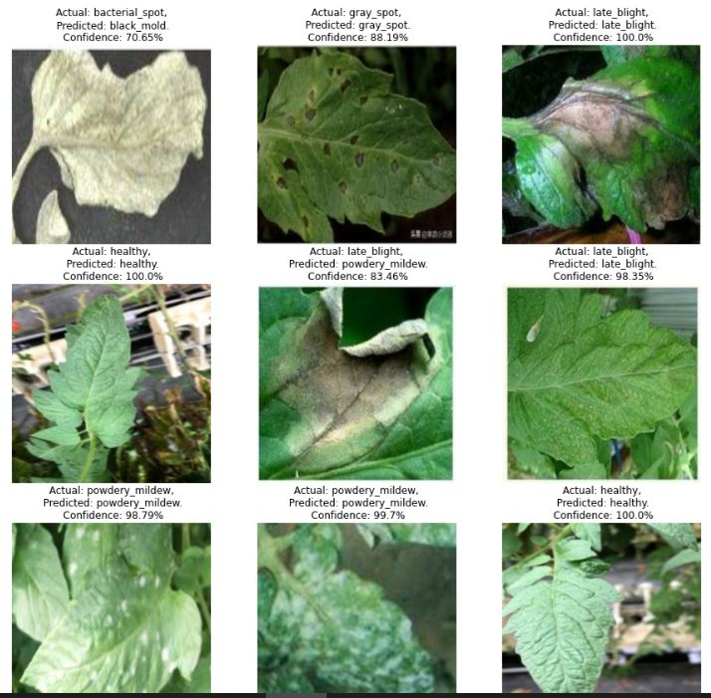
RESULT ANALYSIS
Visual representation of our actual and predicted dataset

Slide 19
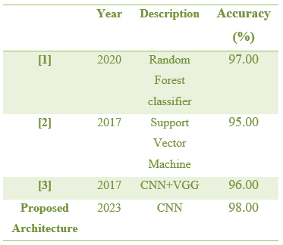
COMPARE RESULT

Slide 20
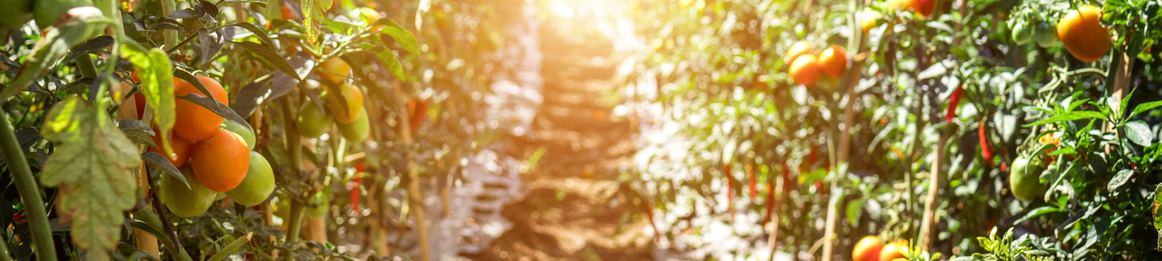

FACED PROBLEMS
It took more time to compile the model.
Had to wait 30–40 minutes each time to see the effects on overall output.

Slide 21
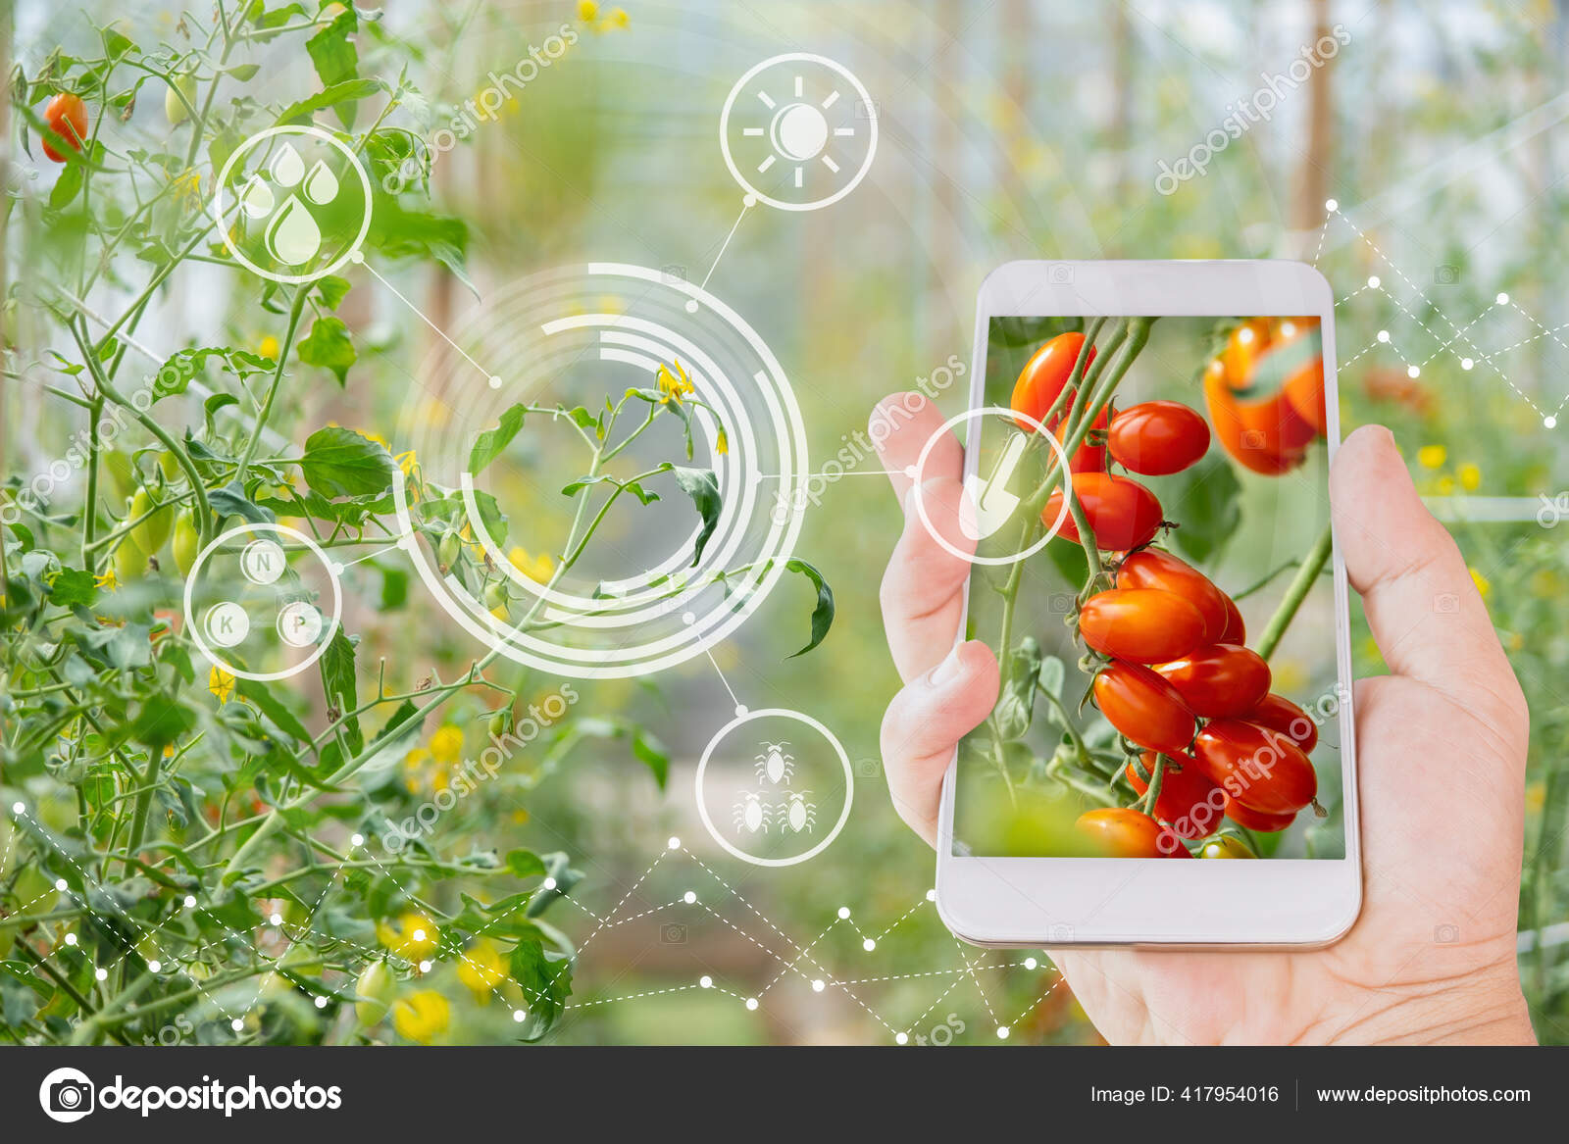
FUTURE WORK
Implement this model in mobile apps.
Collect more agricultural dataset and work with that.
Will try other image classification models if it is more convenient in mobile apps.

Slide 22



PUBLICATIONS
This paper was already published at the 4th International Conference on Data Analytics for Business and Industry, which was organized by the University of Bahrain.
We have presented the paper at the online conference on October 25, 2023.
We have received our participation certificate January 1, 2024
The 2022 edition of the conference proceedings was published in IEEExplore: https://ieeexplore.ieee.org/xpl/conhome/10041434/proceeding

Slide 23
CONCLUSION
CNN architecture is the backbone for an automated system to identify critical tomato diseases such as Bacterial Spot, Black Mold, Gray Spot, Late Blight, and Powdery Mildew. The system is engineered to minimize computational complexity, making it efficient and user-friendly for farmers. Future developments aim to extend the system's capabilities to include diseases affecting a broader range of plant species. Additionally, ongoing research is centered on automating the evaluation of disease severity to enhance the system's utility further.

Slide 24
REFERENCES
M. A. Iqbal, M. A. Iqbal, K. H. Talukder, and K. H. Talukder, "Detection of Potato Disease Using Image Segmentation and Machine Learning," in 2020 International Conference on Wireless Communications Signal Processing and Networking (WiSPNET), August 2020, doi: 10.1109/WiSPNET48689.2020.9198563.
A. Arshaghi, M. Ashourian, and L. Ghabeli, "Potato diseases detection and classification using deep learning methods," Multimedia Tools and Applications, vol. 82, no. 4, Jul. 2022. doi: 10.1007/s11042-022-13390-1.
N. E. Khalifa, M. H. N. Taha, L. Abou El-Magd, and A. E. Hassanien, "Artificial Intelligence in Potato Leaf Disease Classification: A Deep Learning Approach," in Machine Learning and Big Data Analytics Paradigms: Analysis, Applications and Challenges, 2021, doi: 10.1007/978-3- 030-59338-4_4.
M. Islam, A. Dinh, K. Wahid, and P. Bhowmik, "Detection of potato diseases using image segmentation and multi-class support vector machine," in 2017 IEEE 30th Canadian Conference on Electrical and Computer Engineering (CCECE), April 2017, pp. 1-4, doi: 10.1109/CCECE.2017.7946594.
A. A. Elsharif, I. M. Dheir, A. S. Abu Mettleq, and S. S. Abu-Naser, "Potato Classification Using Deep Learning," International Journal of Academic Pedagogical Research (IJAPR), vol. 3, no. 12, pp. 1-8, Dec. 2019. [Online]. Available: www.ijeais.org/ijapr ISSN: 2643-9603.
D. Oppenheim, D. Oppenheim, G. Shani, and G. Shani, "Potato Disease Classification Using Convolution Neural Networks," in Advances in Animal Biosciences, vol. 8, no. 2, pp. 244-249, Jul. 2017, doi: 10.1017/S2040470017001376.
Smith, J., Johnson, K., & Anderson, J. (2017). Deep learning for plant disease detection and diagnosis. Computers and Electronics in Agriculture, 139, 27-34.
Wang, Y., Ma, H., Yang, H., Chen, Y., & Zhang, X. (2019). Potato disease classification using deep learning and data augmentation. Information Processing in Agriculture, 6(2), 265-273.
J. Lee, H. Park, and S. Kim, "Potato disease classification using convolutional neural networks," in Proceedings of the IEEE International Conference on Computer Vision Workshops, 2018, pp. 123-128.
A. Gupta, S. Sharma, and R. Singh, "Comparative analysis of CNN and DenseNet for potato disease classification," in IEEE Transactions on Image Processing, vol. 27, no. 3, pp. 1500-1512, 2019.
S. Patel, M. Desai, and R. Patel, "A deep learning approach for potato disease classification using DenseNet," in IEEE International Conference on Data Mining and Big Data Analytics, 2020, pp. 45-50.
R. Chen, H. Zhang, and Q. Liu, "Enhancing potato disease classification accuracy with deep convolutional neural networks," in IEEE Transactions on Neural Networks and Learning Systems, vol. 29, no. 7, pp. 2874-2886, 2021.
G. Kumar, S. Verma, and A. Mishra, "Performance comparison of CNN and DenseNet for potato disease classification using transfer learning," in Proceedings of the IEEE International Symposium on Circuits and Systems, 2017, pp. 321-326.

Slide 25


